Slide 1

DEVCORE I.T SOLUTIONS
DEVCORE I.T SOLUTIONS
DEVCORE I.T SOLUTIONS
WE MAKE EACH SYSTEM, UNIQUE AND USER FRIENDLY
DEVCORE I.T SOLUTIONS

Slide 2
WHO WE ARE
WHO WE ARE
We are DEVCORE I.T SOLUTIONS, founded in the 12th of January 2019 in Manila, Philippines. As a sole proprietor company, time goes by the company grow stronger as one, bound by the same initiative and ideology to make all of our products unique and consumer friendly and with the initiative and help of its 2 older siblings, they decided to Incorporate the company in the year 2020.
DEVCORE I.T SOLUTIONS

Slide 3











OUR CLIENTS
OUR CLIENTS
DEVCORE I.T SOLUTIONS

Slide 4
PARTNERS
PARTNERS
DEVCORE I.T SOLUTIONS

Slide 5


PARTNERS
PARTNERS
DEVCORE I.T SOLUTIONS

Slide 6
SERVICES
SERVICES
DEVCORE I.T SOLUTIONS

Slide 7



ANALYTICS CREATIVES DEVELOPMENT
ANALYTICS CREATIVES DEVELOPMENT
DEVCORE I.T SOLUTIONS

Slide 8

DEVELOPMENT
DEVELOPMENT
APPLICATION DEVELOPMENT
WEBSITE DEVELOPMENT
BUSINESS PROCESS AUTOMATION
API INTEGRATION
E-COMMERCE & CHATBOT
DEVCORE I.T SOLUTIONS

Slide 9

CREATIVES
CREATIVES
WEB & APPLICATION ASSET DESIGN
SOCIAL MEDIA CONTENT CREATION
MAIL CONTENT CREATION
GRAPHIC DESIGN
DEVCORE I.T SOLUTIONS

Slide 10

ANALYTICS
ANALYTICS
SYSTEM ANALYSIS
REPORT GENERATION
DEVCORE I.T SOLUTIONS

Slide 11




MEET DEVCORE BOARD
MEET DEVCORE BOARD
DEVCORE I.T SOLUTIONS

Slide 12
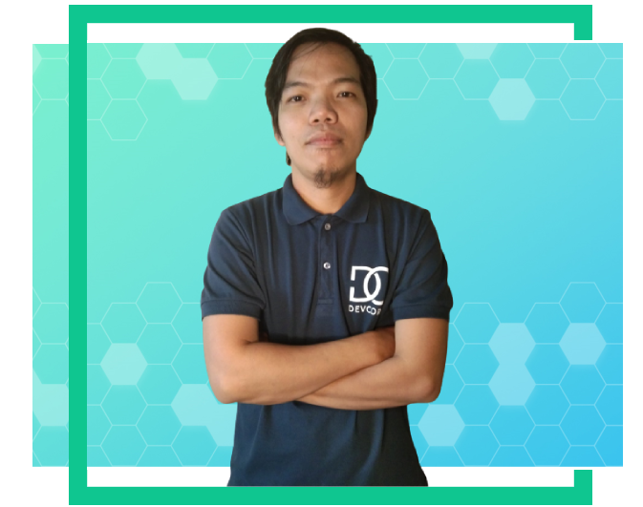

MEET DEVCORE MANAGEMENT
MEET DEVCORE MANAGEMENT
DEVCORE I.T SOLUTIONS

